Slide 1
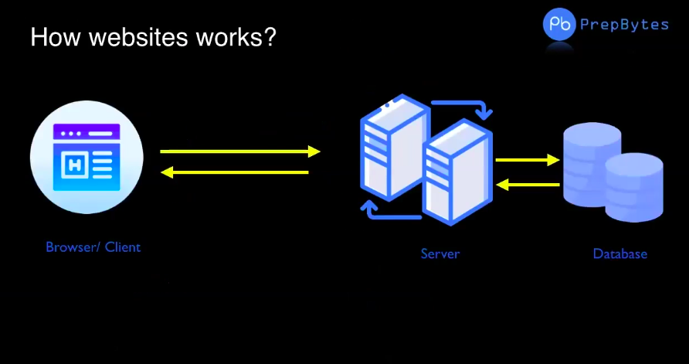

Slide 2
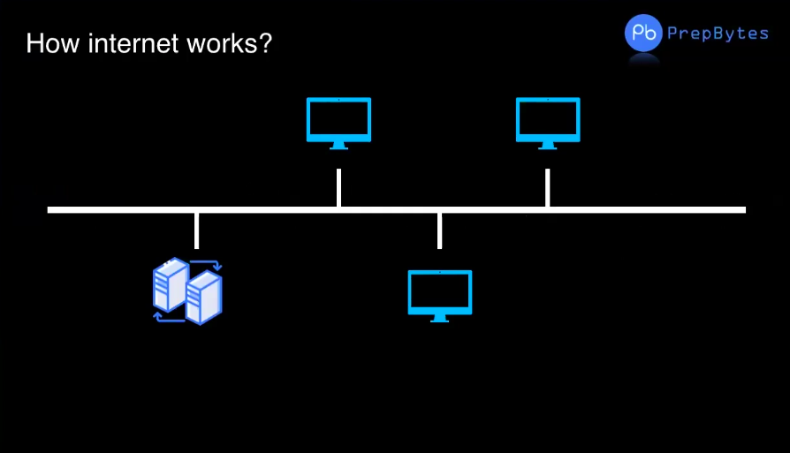

Slide 3
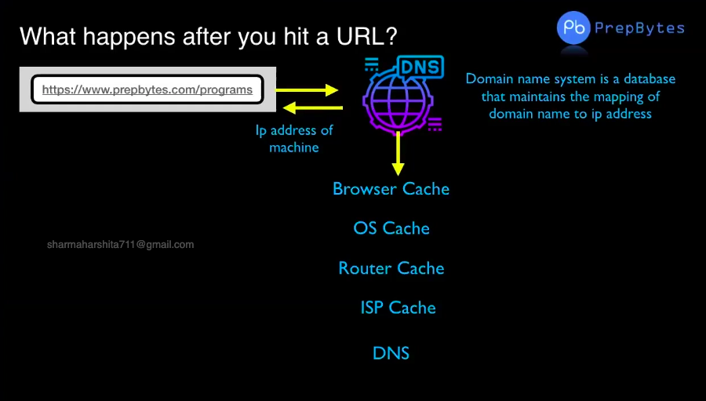

Slide 4


What is DNS?

Slide 5
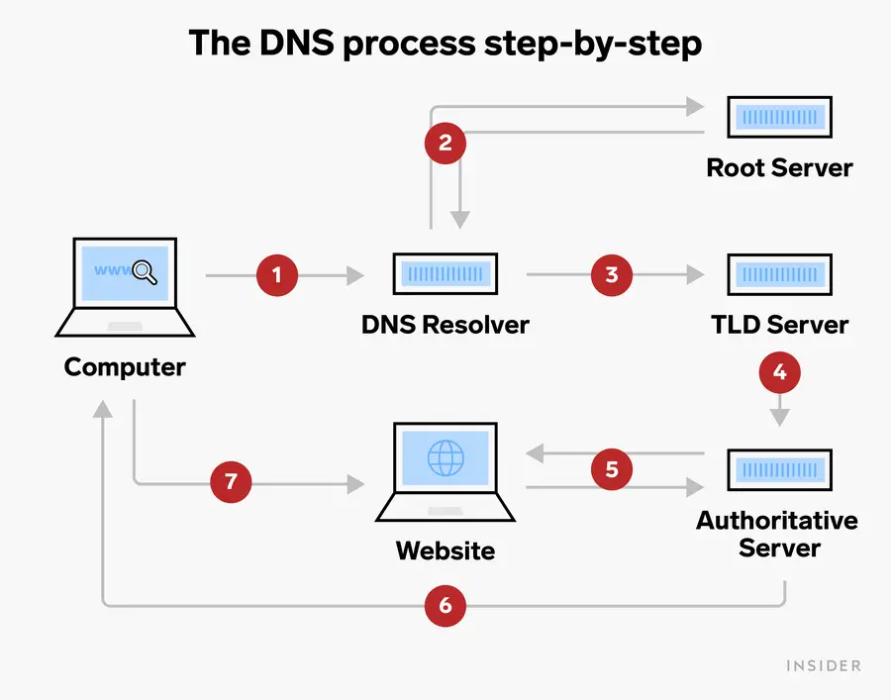
What is DNS?

Slide 6
What is DNS?
A DNS server – short for Domain Name System server – it converts web addresses into IP addresses.
Without a DNS server, we won't be able to connect to any websites.
If we 're having issues with our default DNS server, we can change it.
A Domain Name System (DNS) server is a fundamental part of the backbone of the internet - without it, it will not be possible to use a web browser to find websites.
We can think of the DNS server as a phone book. When we ask our computer to load a website, the DNS server matches the website's name with the right IP address. This lets our computer to find it and load it properly.

Slide 7
How does a DNS server work?
When we enter a URL, what we ‘re really doing is asking our computer to find and connect to another IP address. To do this, DNS uses a set of related servers, all of which form the DNS server:
The DNS recursive resolver
The root nameservers
The TLD nameservers
The authoritative nameservers

Slide 8
The DNS process, step-by-step
1. We ask our web browser to load a website. Since computers don't speak English, our browser can't read a name like "www.insider.com" and instead needs an IP address. Because of which, it sends our request to a DNS recursive resolver. The DNS recursive revolver's goal is to find the IP address connected to the website we entered.
2. The resolver's first step is to find the website's "Top Level Domain" or "TLD" - in other words, whether it's a .com, .net, .org, or another type of site. It does this by asking the root nameserver, which keeps a list of every website in each TLD.
3. Once the resolver knows the TLD, it goes to the corresponding TLD nameserver (for example, the .com nameserver) and asks it to find the right IP address.
4. The TLD nameserver finds the IP address and hands it off to the authoritative nameserver, which will figure out if that address is correct.

Slide 9
The DNS process, step-by-step
5. The authoritative nameserver sends a message to the address and waits for a response - if it gets the right response, then it has the right IP address for the website we want.
6. If the IP address is correct, the authoritative nameserver sends it back to our web browser.
7. Once our web browser receives the right IP address, our webpage starts to load.
All this happens in a matter of seconds - if our internet is very fast, or if we 've visited the website recently then loading can happen in milliseconds.

Slide 10
HTML

Slide 11
Content
What is HTML?
HTML Tag
HTML Boilerplate
Box Model
Texts in HTML
Lists
Images
Forms
Table
Iframes
Videos
Div and span

Slide 12

Introduction to HTML

Slide 13


HTML is the basic building block of a web page
Heading
subheading
button
Heading
Hi! Welcome to the world of learning

Slide 14
What does HTML stand for?
HTML - Hypertext Markup Language

Slide 15
What is HTML ?
HTML stands for Hyper Text Markup Language
HTML is the standard markup language for creating Web pages
HTML describes the structure of a Web page
HTML consists of a series of elements
HTML elements tell the browser how to display the content

Slide 16
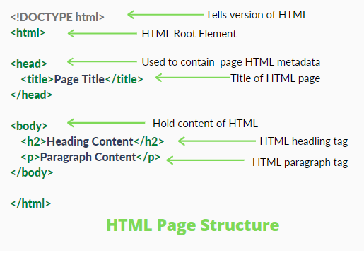
HTML Page Structure

Slide 17
Explanation For Above Sample Document
The <!DOCTYPE html> declaration defines that this document is an HTML5 document
The <html> element is the root element of an HTML page
The <head> element contains meta information about the HTML page
The <title> element specifies a title for the HTML page (which is shown in the browser's title bar or in the page's tab)
The <body> element defines the document's body, and is a container for all the visible contents, such as headings, paragraphs, images, hyperlinks, tables, lists, etc.
The <h1> element defines a main heading. There are <h1> to <h6> variants of heading tags, each have different standard sizes for the heading.
The <p> element defines a paragraph.

Slide 18
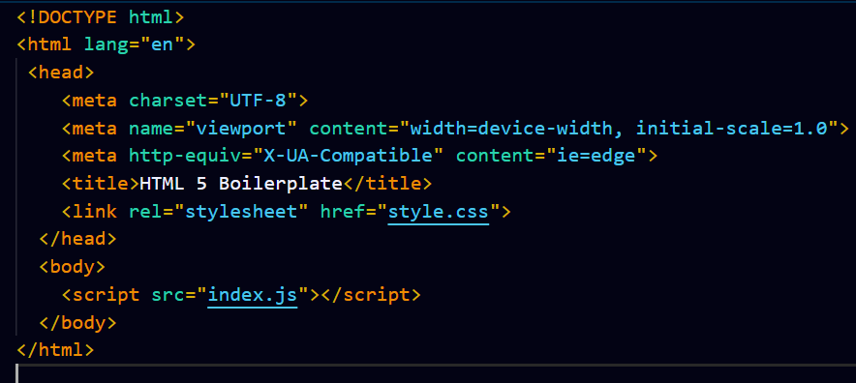
HTML Boiler Plate
A boilerplate in HTML is a template which we have to add at the starting of our project. We should add this boilerplate to all of your HTML pages.
Example of HTML 5 boiler plate

Slide 19
HTML Tags

Slide 20
Basic Tags Used In HTML5
<html> --------> Html Document
<head> ---------> Page Information
<title> ----------> Name in the title bar
<body> -----------> Page Contents
<h1> to <h6> ------------> For Heading, <h1>being largest of all
<p> ------------> For Paragraph
<a href=”url”> ------------> Page Link
<img src=” ” alt=” ” > ------------>For Adding Image
<form> ------------> For Forms
<div> ------------> Page section
<span> ------------> Inline section
<br> ------------>Line break

Slide 21
HTML Headings
Html headings are used to give headings on the web page.
Html offers six different headings tags h1, h2, h3, h4, h5, and h6.
h1 tag mostly used for important headings like title, and h6 used for the least important headings. <h1> has the largest font size and <h6> has the smallest font size.
The heading is a block-level HTML element which means that it will always start from a new line. The heading element in Html has both a starting tag and an ending tag.
<h1>This is an HTML heading.</h1>

Slide 22
HTML Headings
It is recommended to have one H1 heading – just like we have only one title of the book
It is recommended not to use headings just for font size purpose, as we can manage font size using css as well
We should use a good practice of using the heading in sequence like h1 followed by h2 and so on as long as you don’t require the headings to be of a particular font size only.

Slide 23
Html tag Rank Default size (in Px)
<h1><h1> 1 32
<h2><h2> 2 24
<h3><h3> 3 18
<h4><h4> 4 16
<h5><h5> 5 13
<h6><h6> 6 10

Slide 24
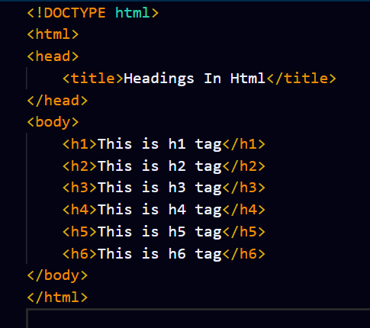
Heading sample Document

Slide 25
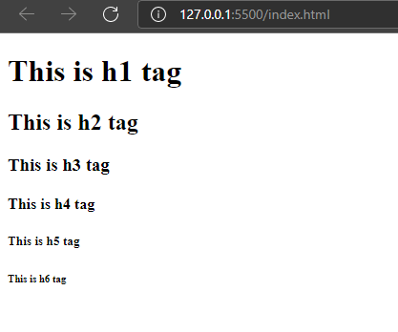
Sample Heading Output

Slide 26
Student Exercise-1
1.Try to create heading using all the heading tags from h1 to h6
2.Create a webpage which will print your name on the screen
3.Create a webpage and set its title to "This is a webpage".

Slide 27
Paragraph Tag
The p element represents a paragraph in an HTML document .
It is a block-level HTML element which means that it will always start from a new line. When we create an HTML paragraph, the browser always creates white space before and after the paragraph.
The p element in html has both a starting tag <p> and an ending tag </p>. All the content of a paragraph is placed between the starting tag and the ending tag.
In Html The paragraph is marked as:
<p>This is a paragraph.</p>

Slide 28
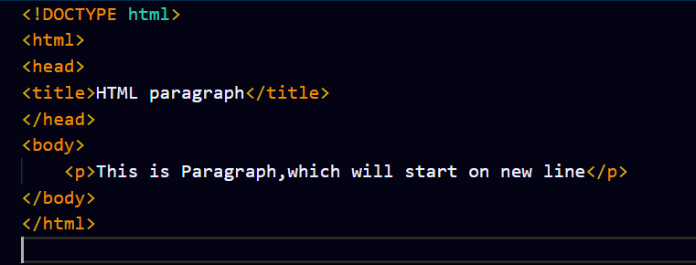
Paragraph sample Document

Slide 29
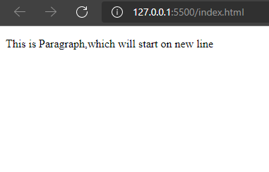
Paragraph sample Document

Slide 30
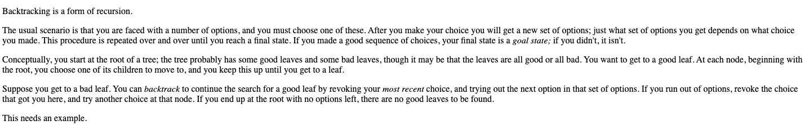
Student Exercise-2
Replicate first four paragraphs of this site: https://www.cis.upenn.edu/~matuszek/cit594-2012/Pages/backtracking.html

Slide 31
HTML paragraph</
Anchor Tag(Known as Heart of HTML)
An anchor tag is a HTML element that creates a link to a target URL.
This link tag can be wrapped around text, images, or as buttons, so that users can interact with it and visit the link's destination.

Slide 32
HTML paragraph</
<a href="https://www.google.com">Google Home</a>
Opening Tag
Attribute Value
Attribute
anchor text
Closing Tag
It will display Google Home with the anchor text in blue color along with a blue color underline, which when clicked will be redirected to the Google Webpage within the same tab/page.

Slide 33
HTML paragraph</
Student Exercise-3
1. Write a text PrepBytes and on clicking the text, it should redirect to Prepbytes website on same tab.
2. Write a text PrepBytes and on clicking the text, it should redirect to Pepbytes website on a new tab.
3. Create two html files named as index1 and index2, and create a link between 2 files.
4. Create some links to various search engines (google, yahoo, altavista, lycos, etc).

Slide 34
Modify texts style
em vs i
strong vs bold
sub vs sup
ins vs del
mark
small
pre
code
strike
block quote

Slide 35

em vs i
em – It is used to define emphasized texts. It semantically emphasizes on the important word or section of words.
i – It is just offset text conventionally styled in italics to show alternative mood or voice

Slide 36
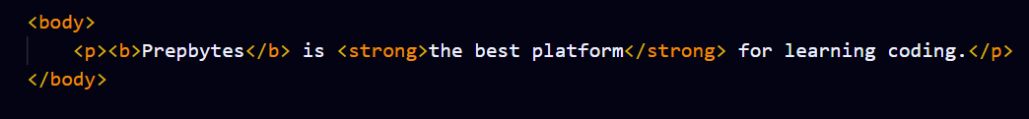

Strong vs bold
strong - It semantically emphasizes on the important word or section of words <strong>text</strong>
Bold – It is just used to offset text styled in bold <b> text </b>

Slide 37
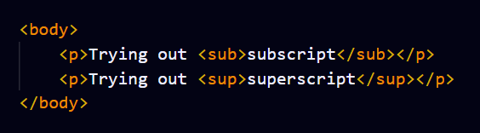
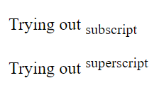
Sub vs sup
sub - The <sub> tag is used to add a subscript text to the HTML document.
sup - The <sup> tag is used to add a superscript text to the HTML document.

Slide 38
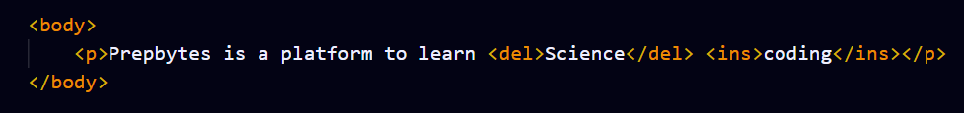

Ins vs del
ins - The <ins> tag is typically used to mark a range of text that has been added to the document.
del – The <del> tag is used to represent the range of text that has been deleted/removed from the document.

Slide 39
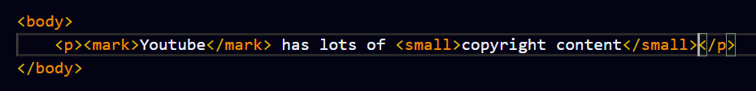

mark vs small
The <mark> tag defines text that should be marked or highlighted.
mark – The mark tag defines text that should be marked or highlighted
small - The <small> tag defines smaller text (like copyright and other side-comments).

Slide 40
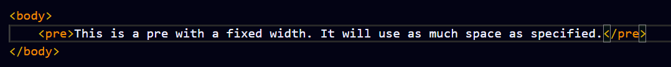
pre tag
The <mark> tag defines text that should be marked or highlighted.
Text in a <pre> element is displayed in a fixed-width font, and the text preserves both spaces and line breaks. The text will be displayed exactly as written in the HTML source code.
pre – Pre tag preserves both spaces and line breaks. The text will be displayed exactly as it’s written in the source code.

Slide 41
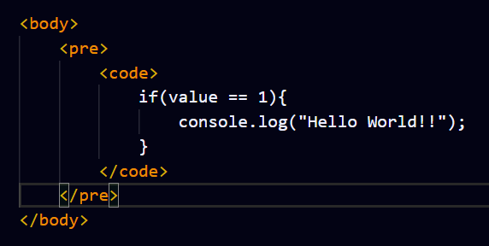
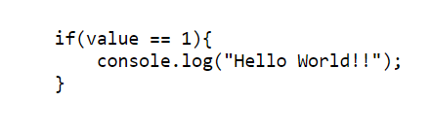
code tag
The <mark> tag defines text that should be marked or highlighted.
Text in a <pre> element is displayed in a fixed-width font, and the text preserves both spaces and line breaks. The text will be displayed exactly as written in the HTML source code.
Code - The <code> tag is used to define a piece of computer code. The content inside is displayed in the browser's default monospace font.

Slide 42
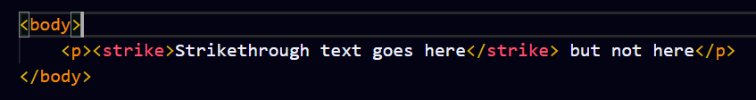

strike tag
The <mark> tag defines text that should be marked or highlighted.
Text in a <pre> element is displayed in a fixed-width font, and the text preserves both spaces and line breaks. The text will be displayed exactly as written in the HTML source code.
strike - The HTML <strike> tag gives text the appearance of a strikethrough which draws a horizontal line over the text.

Slide 43
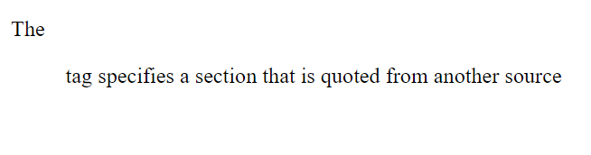
Block quote tag
The <mark> tag defines text that should be marked or highlighted.
Text in a <pre> element is displayed in a fixed-width font, and the text preserves both spaces and line breaks. The text will be displayed exactly as written in the HTML source code.
block quote - The <blockquote> tag specifies a section that is quoted from another source. The Browser usually displays the content within <blockquote> tag as indented text.

Slide 44
Empty Tags or self closing tags
<hr>
<br>
<img>
<input>

Slide 45
hr tag
The <hr> tag in HTML stands for horizontal rule and is used to insert a horizontal rule or a thematic break in an HTML page to divide or separate document sections.
The <hr> tag is an empty tag, and it does not require an end tag. Therefore it’s also known as self closing tag.

Slide 46
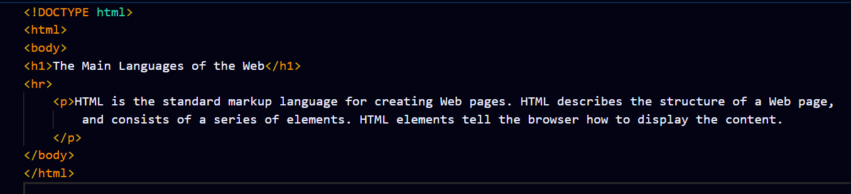
hr tag

Slide 47
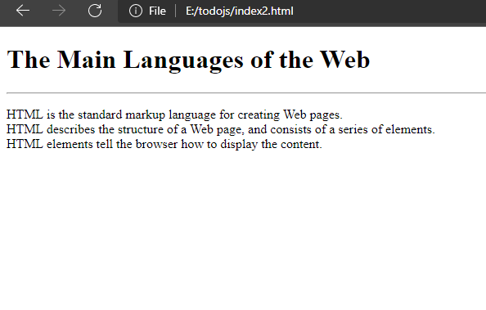
hr tag

Slide 48
br tag
The <br> tag inserts a single line break.
The <br> tag is useful for writing addresses or poems.
The <br> tag is an empty tag which means that it has no end tag i.e. its also a self closing tag.

Slide 49
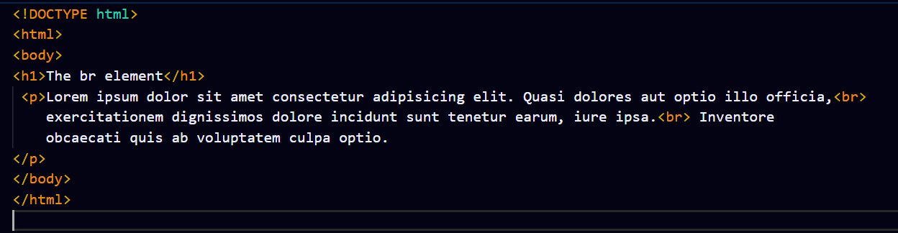
br tag

Slide 50
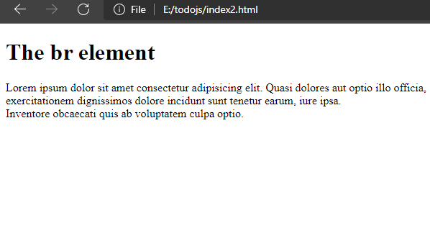
br tag

Slide 51
HTML paragraph</
Image Tag
The <img> tag is used to embed an image in an HTML page.
Images are not technically inserted into a web page; instead images are linked to web pages. The <img> tag creates a holding space for the referenced image.
The <img> tag has two required attributes:
src - Used to specify the path to the image
alt – Used to specify an alternate text for the image, if the image for some reason cannot be displayed.
Note: Always specify the width and height of an image. If width and height are not specified, the page might flicker while the image loads.

Slide 52
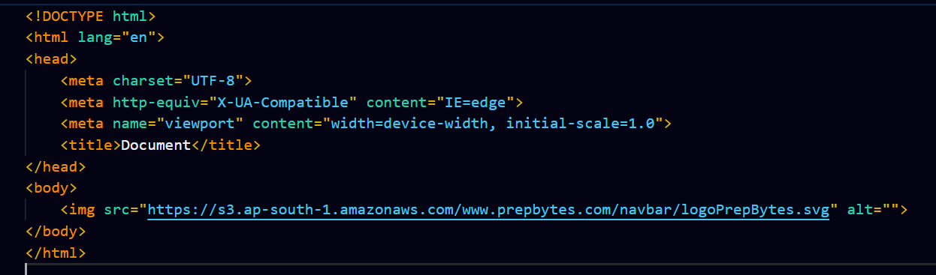
HTML paragraph</
Image Tag Example
Image Tag Example

Slide 53
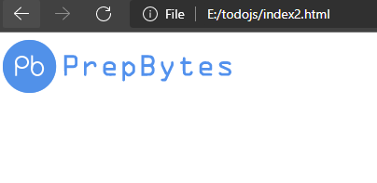
HTML paragraph</
Image Tag Example
Image Tag Output

Slide 54
HTML paragraph</
Image Tag Example
Student Exercise-3
1. img src =https://www.cis.upenn.edu/~matuszek/cit594-2012/Pages/backtracking_files/treesearch.gif
Add above image using the url given Also, download the image and add it using relative and absolute path
2. Display an image that has a border of size 2, a width of 200px, and a height of 200px.
3. Display an image that when clicked will link to a search engine of your choice (should be opened in a new window).

Slide 55
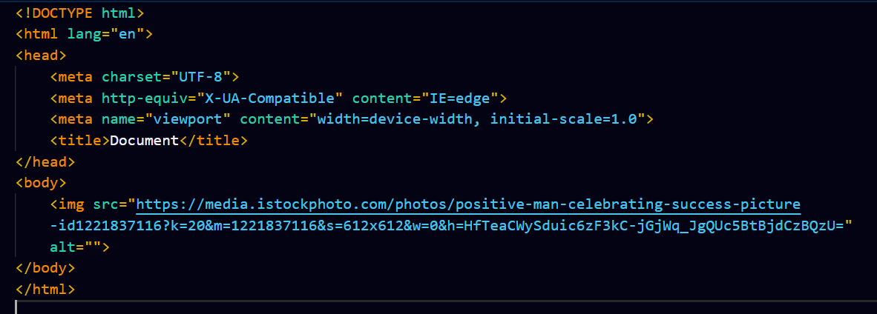
HTML paragraph</
Absolute path
An absolute file path is the full URL to a file

Slide 56

HTML paragraph</
Absolute path

Slide 57
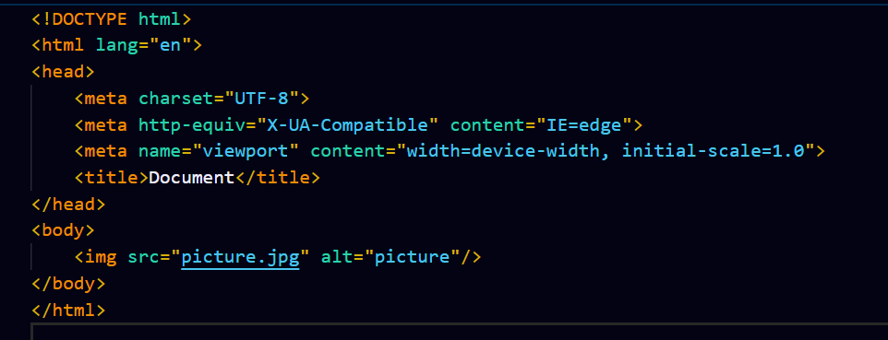
HTML paragraph</
Relative path
A relative file path points to a file relative to the current page.
In the following example, the file path points to a file in the images folder located in the current folder

Slide 58
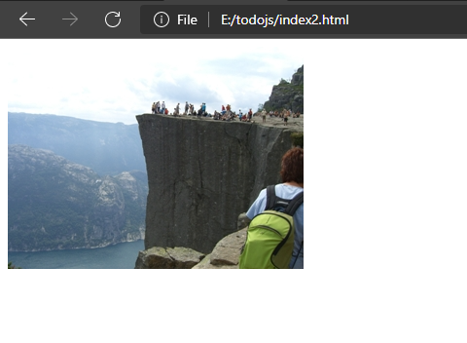
HTML paragraph</
Relative path

Slide 59
HTML paragraph</
Image Tag Example
HTML List
HTML lists allow web developers to group a set of related items in lists.
It consists of two types
1.Ordered List
2.Unordered List

Slide 60
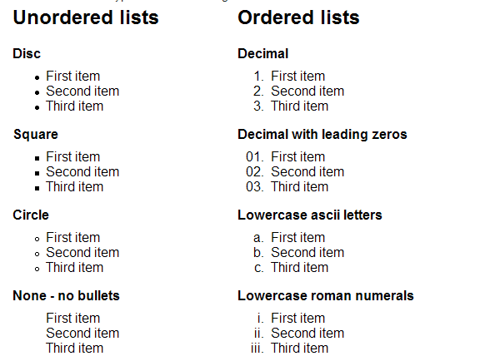
HTML paragraph</
Image Tag Example
HTML List

Slide 61
HTML paragraph</
Image Tag Example
HTML Unordered List
An unordered list starts with the <ul> tag. Each list item starts with the <li> tag.The list items will be marked with bullets (small black circles) by default:
Value Description
disc Sets the list item marker to a bullet (default)
circle Sets the list item marker to a circle
square Sets the list item marker to a square
none The list items will not be marked
Value | Description
disc | Sets the list item marker to a bullet (default)
circle | Sets the list item marker to a circle
square | Sets the list item marker to a square
none | The list items will not be marked

Slide 62
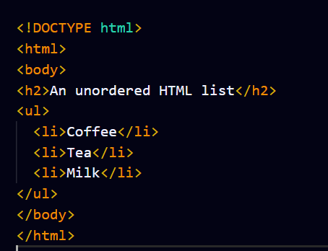
HTML paragraph</
Image Tag Example
HTML unordered List

Slide 63
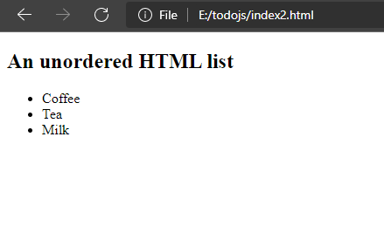
HTML paragraph</
Image Tag Example
HTML Unordered List - Output
Value Description
disc Sets the list item marker to a bullet (default)
circle Sets the list item marker to a circle
square Sets the list item marker to a square
none The list items will not be marked

Slide 64
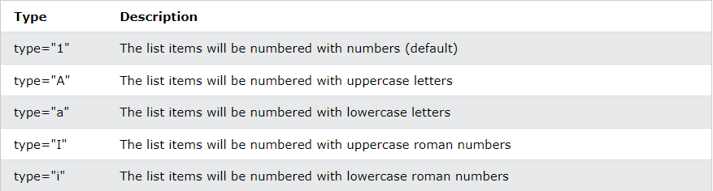
HTML paragraph</
Image Tag Example
HTML Ordered List
An Ordered list starts with the <ol> tag. Each list item starts with the <li> tag.The list items will be marked with numbers by default: (1. , 2. and so on…)
Value Description
disc Sets the list item marker to a bullet (default)
circle Sets the list item marker to a circle
square Sets the list item marker to a square
none The list items will not be marked
Value | Description
disc | Sets the list item marker to a bullet (default)
circle | Sets the list item marker to a circle
square | Sets the list item marker to a square
none | The list items will not be marked

Slide 65
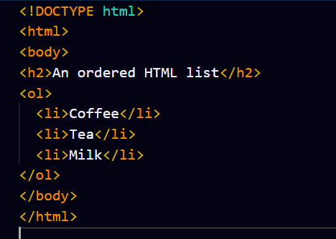
HTML paragraph</
Image Tag Example
HTML Ordered Lists
ype="i" The list items will be numbered with lowercase roman numbers

Slide 66
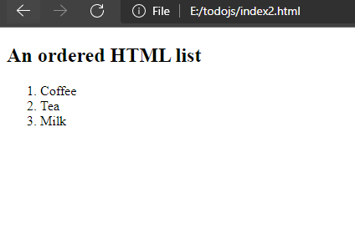
HTML paragraph</
Image Tag Example
HTML ordered List - Output
Value Description
disc Sets the list item marker to a bullet (default)
circle Sets the list item marker to a circle
square Sets the list item marker to a square
none The list items will not be marked

Slide 67
HTML paragraph</
Image Tag Example
Student Exercise-4
1. Create a nested ordered list
2. Create an ordered list in reverse order 3,2,1
3. Create an unordered list of your choice in circle and square type

Slide 68
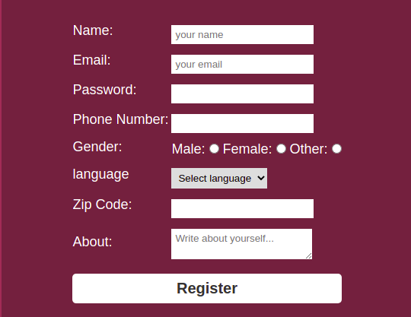
HTML paragraph</
Image Tag Example
HTML Forms
ype="i" The list items will be numbered with lowercase roman numbers

Slide 69
HTML paragraph</
Image Tag Example
HTML Forms
An HTML form is used to collect user input.
The user input is most often sent to a server for processing.
The <form> element is a container for different types of input elements, such as: text fields, checkboxes, radio buttons, submit buttons, etc.
The HTML <input> element is the most used form element.
An <input> element can be displayed in many ways, depending on the type attribute.
ype="i" The list items will be numbered with lowercase roman numbers

Slide 70
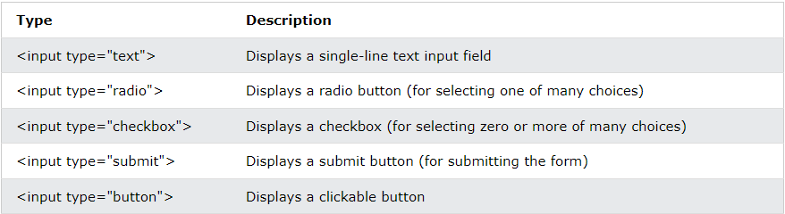
HTML paragraph</
Image Tag Example
HTML INPUTS
ype="i" The list items will be numbered with lowercase roman numbers

Slide 71
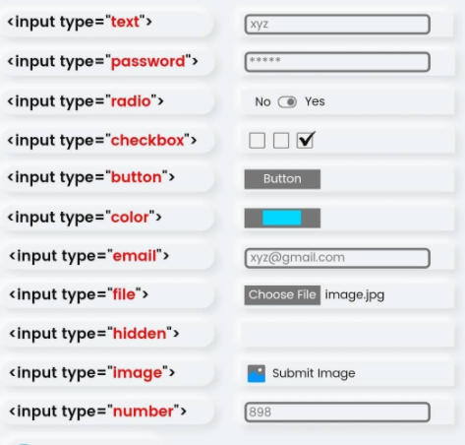
HTML paragraph</
Image Tag Example
HTML INPUTS
ype="i" The list items will be numbered with lowercase roman numbers

Slide 72
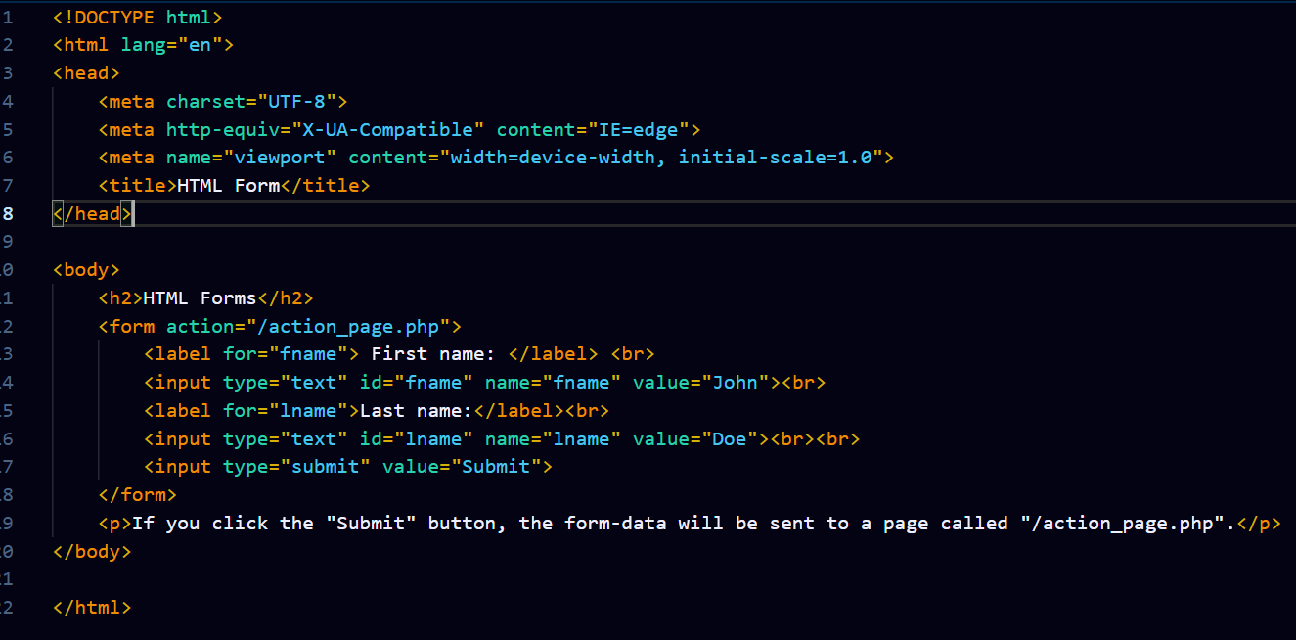
HTML paragraph</
Image Tag Example
HTML Forms

Slide 73
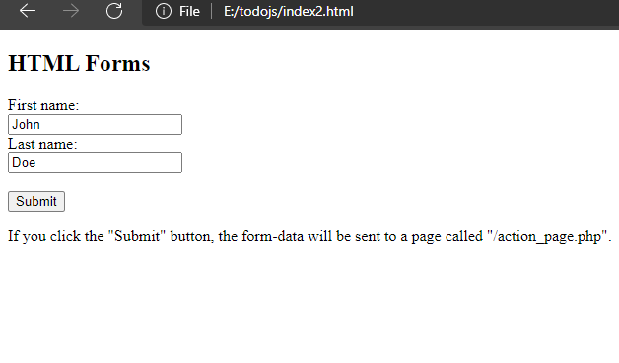
HTML paragraph</
Image Tag Example
HTML Forms

Slide 74
HTML paragraph</
Image Tag Example
HTML Form Dropdown
Dropdown is used to select the options from the list which is having in the dropdown box
The <select> element is used to create a drop-down list.
The <select> element is most often used in a form, to collect user input.
The name attribute is needed to reference the form data after the form is submitted (if we omit the name attribute, no data from the drop-down list will be submitted).
The id attribute is needed to associate the drop-down list with a label.
The <option> tags inside the <select> element define the available options in the drop-down list.

Slide 75
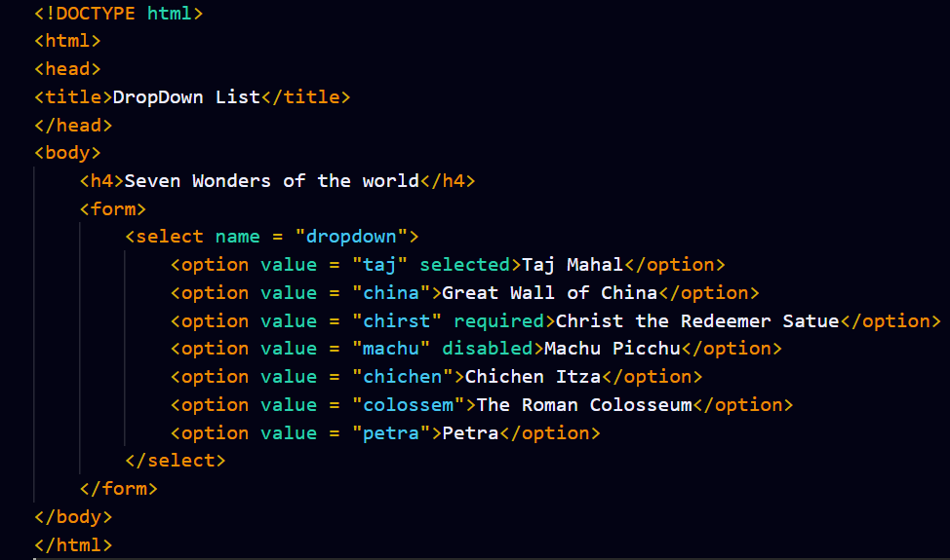
HTML paragraph</
Image Tag Example
HTML Form Dropdown

Slide 76
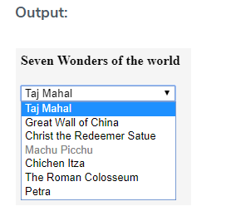
HTML paragraph</
Image Tag Example
HTML Form Dropdown

Slide 77
HTML paragraph</
Image Tag Example
Exercise-6:
1. Replicate HTML of signup form on Prepbytes website
https://www.prepbytes.com/register

Slide 78
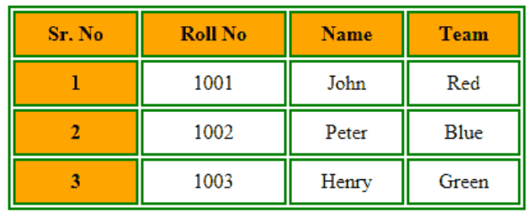
HTML paragraph</
Image Tag Example
HTML Tables

Slide 79
HTML paragraph</
Image Tag Example
HTML Tables
HTML tables allow web developers to arrange data into rows and columns.
Each table cell is defined by a <td> and a </td> tag. td stands for table data.
Each table row starts with a <tr> and end with a </tr> tag.tr stands for table row.
We can have as many rows as we like in a table, we just need to make sure that the number of cells are the same in each row.
To make a cell span over multiple columns, we have to use the colspan attribute.To make a cell span over multiple rows, we have to use the rowspan attribute:

Slide 80
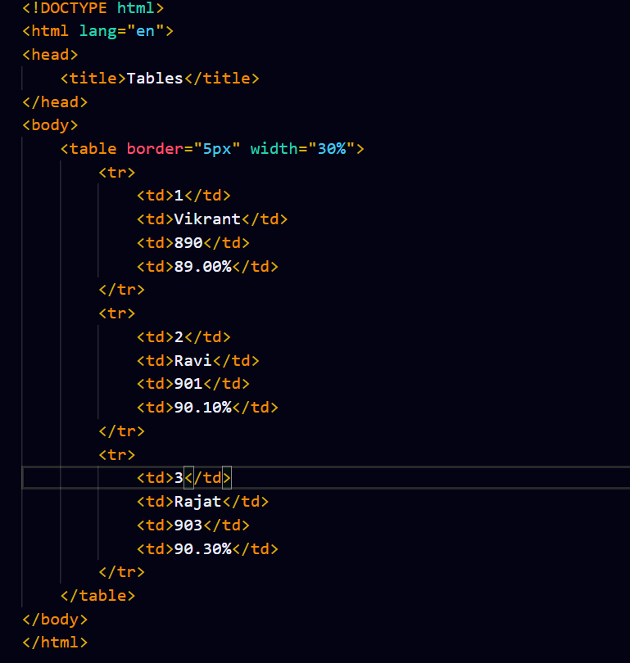
HTML paragraph</
Image Tag Example

Slide 81
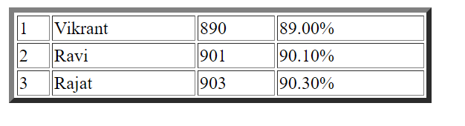
HTML paragraph</
Image Tag Example
Basic Html Table Output

Slide 82
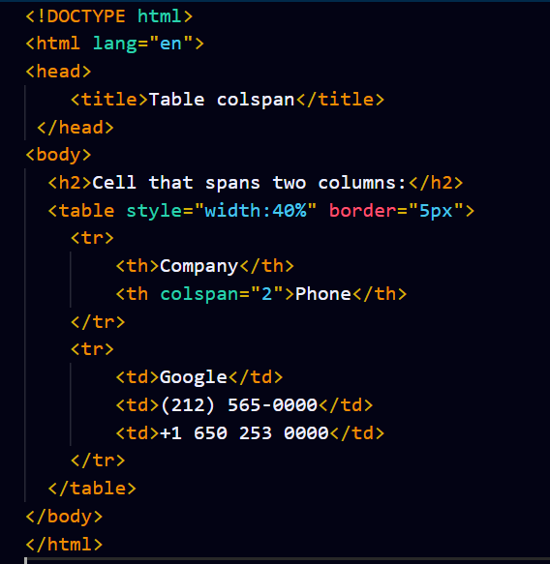
HTML paragraph</
Html Table Colspan
To make a cell span over multiple columns, use the colspan attribute:
To make a cell span over multiple columns, use the colspan attribute:

Slide 83
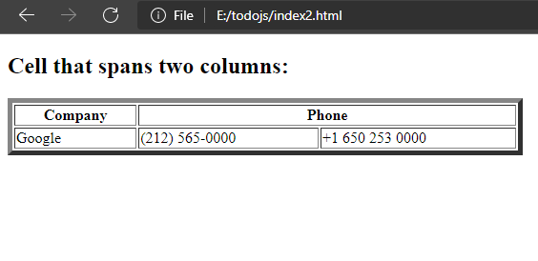
HTML paragraph</
Html Table Colspan
To make a cell span over multiple columns, use the colspan attribute:

Slide 84
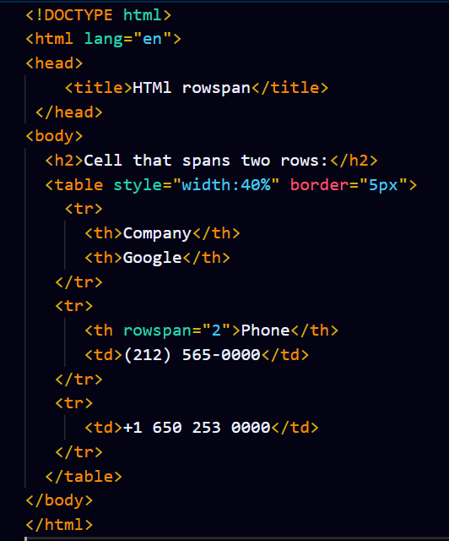
HTML paragraph</
Html Table Rowspan
To make a cell span over multiple rows, use the rowspan attribute:

Slide 85
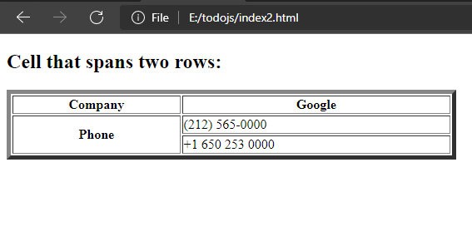
HTML paragraph</
Html Table Rowspan

Slide 86



HTML paragraph</
Exercise – Replicate the three forms given below

Slide 87

HTML paragraph</
Block

Slide 88
HTML paragraph</
Block
A block-level element always starts on a new line.
A block-level element always takes up the full width available (i.e. it stretches out to the left and right as far as it is possible).
A block level element has a top and a bottom margin, whereas an inline element does not.
The <div> element is a block-level element.

Slide 89

HTML paragraph</
Block

Slide 90

HTML paragraph</
Block

Slide 91

HTML paragraph</
Inline Element

Slide 92
HTML paragraph</
Inline Element
An inline element is exactly opposite to that of the block-level element.
It does not start on a new line and takes up only the necessary width i.e., it only occupies the space bounded by the tags defining the HTML element, instead of breaking the flow of the content.
The <span> element is an inline element.

Slide 93

HTML paragraph</
Inline

Slide 94

HTML paragraph</
Inline Element

Slide 95
HTML paragraph</
Image Tag Example
Basic Video Tag
The <video> tag is used to embed video content in a document, such as a movie clip or other video streams.
The <video> tag contains one or more <source> tags with different video sources. The browser will choose the first source it supports.
The text between the <video> and </video> tags will only be displayed in browsers.
We should use control option for showing the contents in the video
at do not support the <video> element.

Slide 96

HTML paragraph</
Image Tag Example
Basic Video Tag

Slide 97

HTML paragraph</
Image Tag Example
Basic Video Tag

Slide 98
HTML paragraph</
Image Tag Example
Iframes In Html
An HTML iframe is used to display a web page within the current Html document.
The HTML <iframe> tag specifies an inline frame.
An inline frame is used to embed another document within the current HTML document.
tThe HTML <iframe> tag specifies an inline frame, the src attribute defines the URL of the page to embed. We must always include a title attribute, (for screen readers) the height and width attributes which specifies the size of the iframe. We can use border:none; to remove the border around the iframe in a web page.

Slide 99

HTML paragraph</
Image Tag Example
Iframes In Html

Slide 100

HTML paragraph</
Image Tag Example
Iframes In Html

Slide 101
HTML paragraph</
Image Tag Example
section
Section tag defines the section of documents such as chapters, headers, footers or any other sections.
The section tag divides the content into section and subsections.
The section tag is used when requirements of two headers or footers or any other section of documents needed. Section tag is used to group the generic block of related contents.
The main advantage of the section tag is, it’s a semantic element, which describes its meaning to both browser and developer.

Slide 102

HTML paragraph</
Image Tag Example

Slide 103

HTML paragraph</
Image Tag Example
section

Slide 104
HTML paragraph</
Image Tag Example
nav
The <nav> tag defines a set of navigation links.
We should be careful that NOT all links of a document should be inside a <nav> element. The <nav> element is intended only for major block of navigation links.
Browsers, such as screen readers for disabled users, can use this element to determine whether to omit the initial rendering of this content or not.

Slide 105

HTML paragraph</
Image Tag Example

Slide 106

HTML paragraph</
Image Tag Example
nav

Slide 107
HTML paragraph</
Image Tag Example
Header

Slide 108

HTML paragraph</
Image Tag Example
Header

Slide 109

Header Tag output

Slide 110

HTML paragraph</
Image Tag Example
Footer

Slide 111
HTML paragraph</
Image Tag Example
Footer
The <footer> tag in HTML is used to define a footer of HTML document.
This section contains the footer information like (author information, copyright information, carriers, etc).
The footer tag is used within the body tag only.
The <footer> tag is new in the HTML5. The footer elements require a start tag as well as an end tag.

Slide 112

Footer Tag

Slide 113

Footer Tag output

